Slide 1
Enhancing Google’s Domain Adaptation Research
Group 2
Gabriel Ribeiro, Devin Cole, Maria Mosquera, Saad Waraich

Slide 2
"Unsupervised Pixel-Level Domain Adaptation with Generative Adversarial Networks"

Slide 3
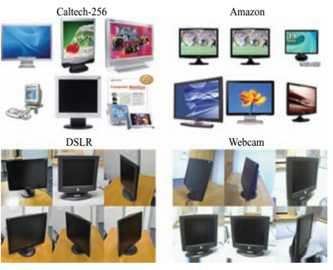
Domain Adaptation
Unsupervised
Semi-supervised
Supervised

Slide 4
Google’s Research
Generator for fake images
Discriminator to distinguish between fake and real source images
Training classifier on fake and real source images

Slide 5
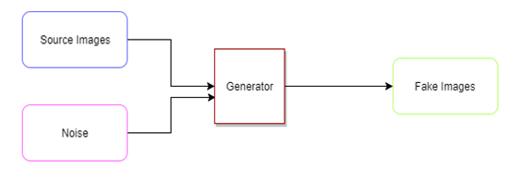
Generator

Slide 6
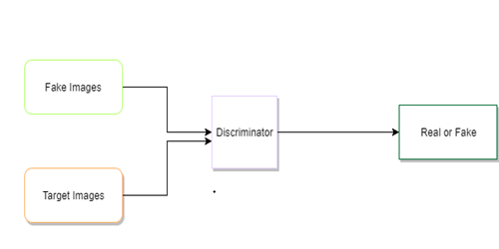
Discriminator

Slide 7
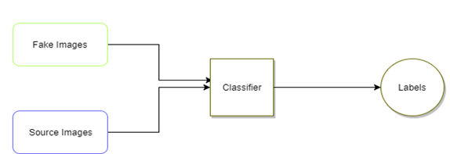
Classifier

Slide 8
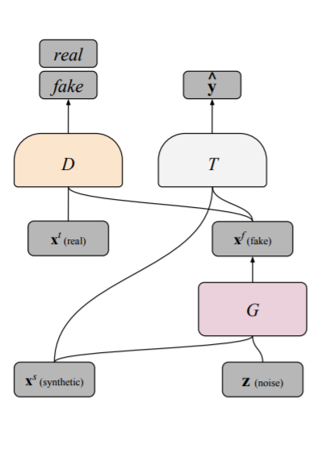
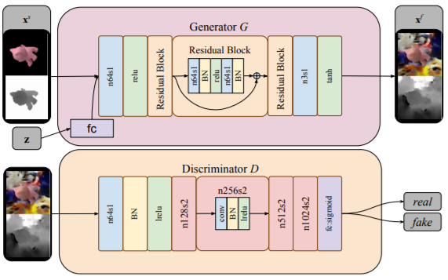
Google’s Generative Adversarial Network (GAN) Architecture

Slide 9
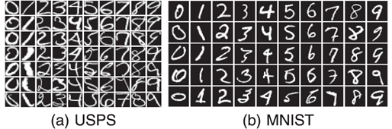
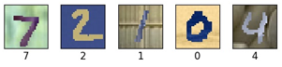
Datasets
MNIST: 70,000 images of handwritten digits (32x32 pixels)
USPS: Set of handwritten digits scanned from USPS envelopes (16x16 pixels)
MNIST-M: Modified MNIST images with random color patches

Slide 10
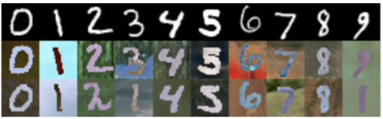
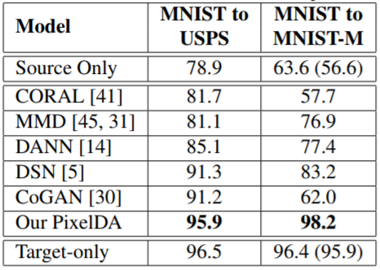
Google’s Results
MNIST to MNIST-M
Classification Accuracy: 98.2%
MNIST to USPS
Classification Accuracy: 95.9%

Slide 11
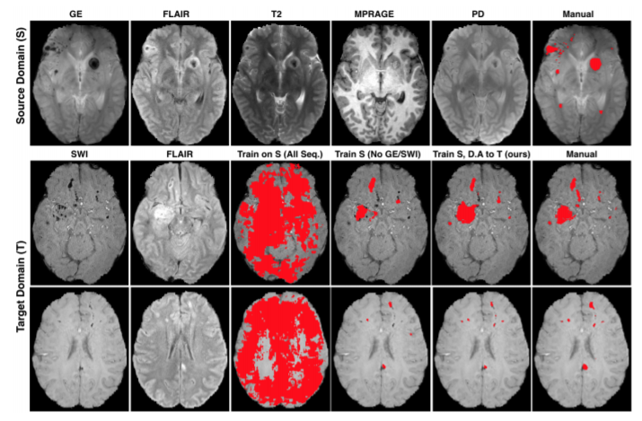
Potential Applications
Healthcare
Education
Search and Rescue
Healthcare: Domain Adaptation for Brain Lesions

Slide 12
What We Did
Replicate Google’s experiment of MNIST to MNIST-M
Research GANs and pixel-level domain adaptation
Create an end to end unsupervised GAN model to try and improve on Google's classification accuracies

Slide 13
Software/Libraries
Tensorflow, Tensorboard
Keras
Numpy
Anaconda/Python
Bazel
Linux Mint

Slide 14
Hardware - Server
UCF server
Personal computer (NVIDIA GTX 1080)
Senior Design Lab GPUs (NVIDIA GTX 1080 Ti)

Slide 15
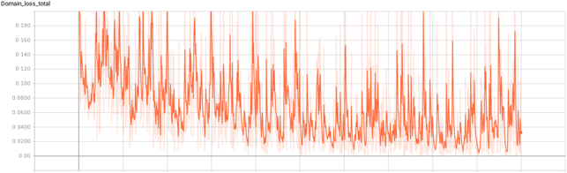
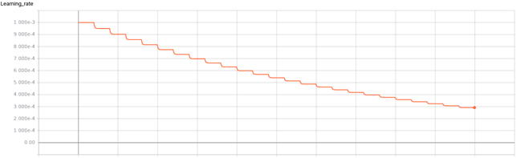
Replicating Google’s Experiment - MNIST to MNIST-M
Batch size = 32
Training examples/steps = 16,000,000/500,000
Learning rate = 0.001
Discriminator loss weight = 0.13
Generator loss weight = 0.011
Classification accuracy:
Run 1 = 94.9%
Run 2 = 98.8%
Average = 96.9%
Notes:
ADD

Slide 16
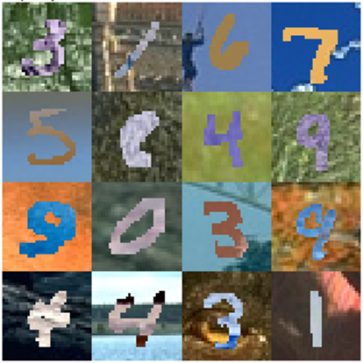
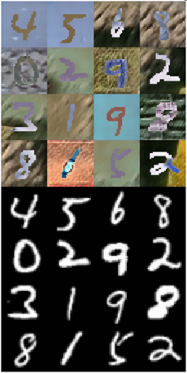
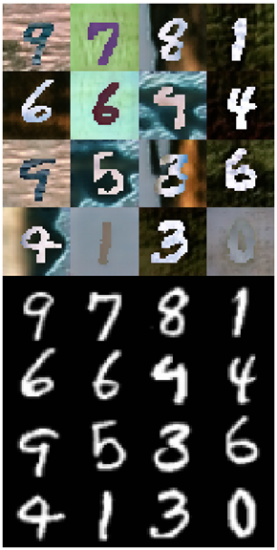
Replicating Google’s Experiment - MNIST to MNIST-M

Slide 17
Proposed Solution
Researched GANs:
Coulomb GANs
Energy Based GANs
Stacked GANs
Bidirectional GANs
Boundary Equilibrium GANs
Our model:
Wasserstein GAN
InfoGAN
Coupled GANs
PixelDA GAN
Couple two Wasserstein GANs – CoWGAN
Couple two InfoGANs – CoIGAN
Couple two PixelDA GANs – CoPixGAN

Slide 18
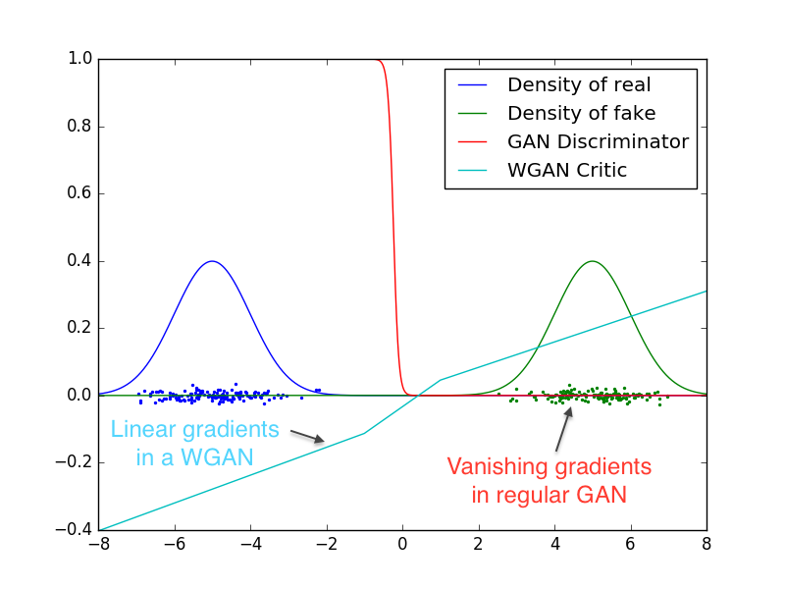
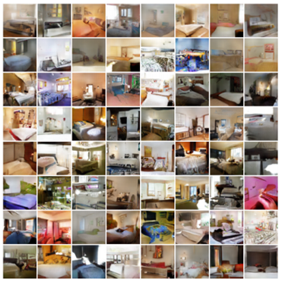
Wasserstein GAN (WGAN)
Earth-Mover/Wasserstein-1 as the loss function
Loss function correlates with convergence and image quality
Clean gradients
Improved optimization stability
Knowledge of training progress

Slide 19
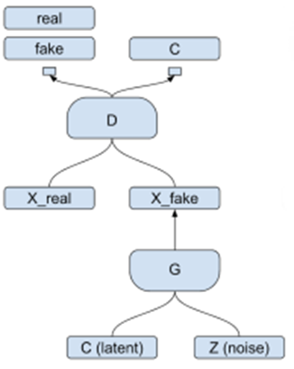
InfoGAN
Standard GAN input not semantically meaningful
Meaningful latent variables
Entirely unsupervised

Slide 20
Coupled GANs
Previous approaches: dataset with tuples of images
Could expand domain adaptation in multiple domains
Current architecture focuses on 2 domains
Architecture comprised of 2 DCGANs
Marginal distribution vs. joint distribution
Learn the joint distribution by sharing of weights
Leads to both discriminative models to learn from each others domains

Slide 21
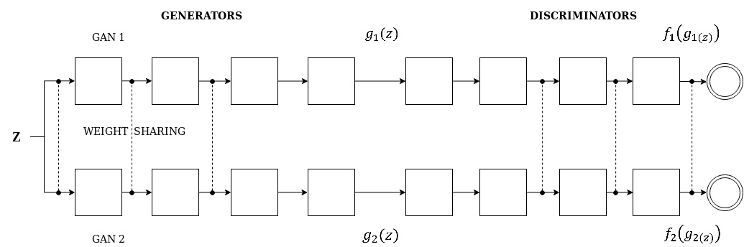
Coupled GANs

Slide 22
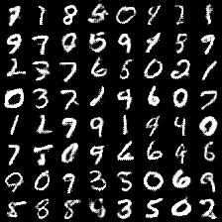
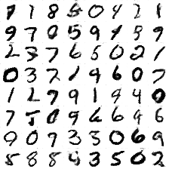
Coupled GANs Results
MNIST → Inverted MNIST

Slide 23
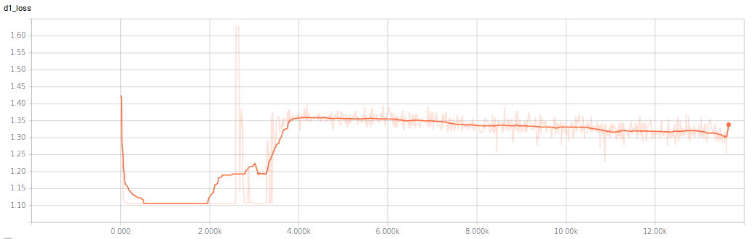
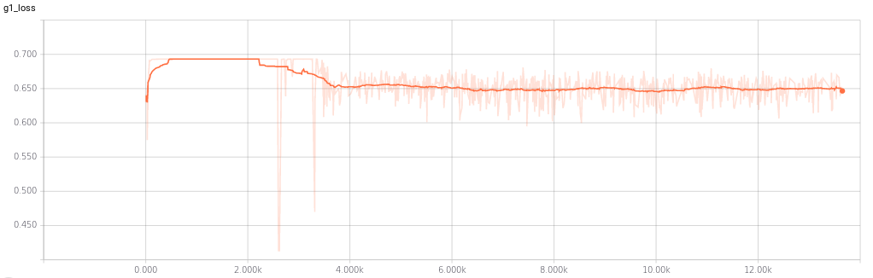
Coupled GANs Results

Slide 24
Coupled GANs
Batch size = 64
Learning rate = 0.0002
Iterations = 13,502

Slide 25
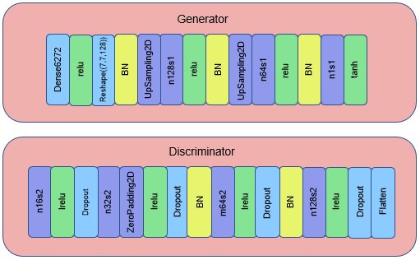
CoWGAN
Generator:
3 convolutional layers
Discriminator:
4 convolutional layers
Partial weight sharing
Run multiple times on MNIST:
Run 1: Learning rate = 0.00005, batch size = 16
Run 2: Learning rate = 0.0001, batch size = 16
Run 3: Learning rate = 0.0002, batch size = 16
Run 4: Learning rate = 0.0001, batch size = 32

Slide 26
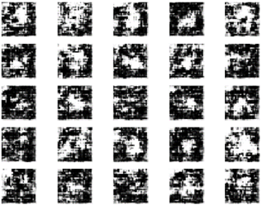
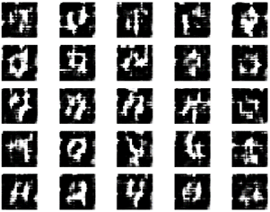
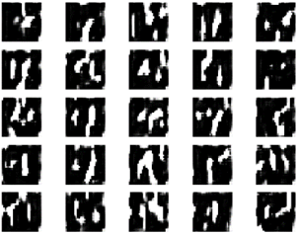
CoWGAN - MNIST
200th Iteration
3000th Iteration
40000th Iteration

Slide 27
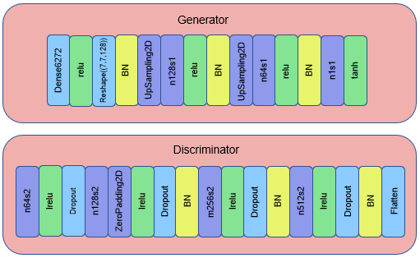
CoIGAN
Merging of CoGAN and InfoGAN
Trained for 30,000 iterations
Batch size: 32, learning rate: .0002, and
beta value of 0.5
Best visual results seen at 30,000 (MNIST),
24,000 (USPS), and 25,000 (MNIST-M)
Partial weight sharing
Accuracies: 52.87% (MNIST),
59.07% (USPS), and 88.01% (MNIST-M)

Slide 28
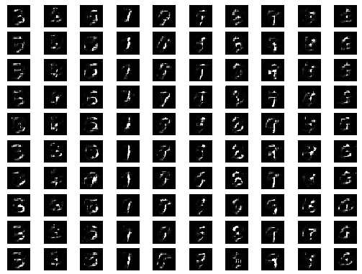
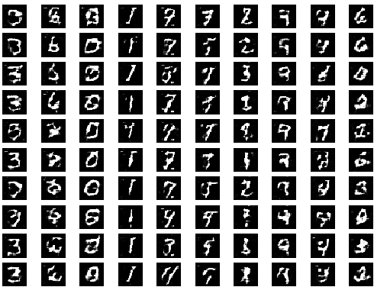
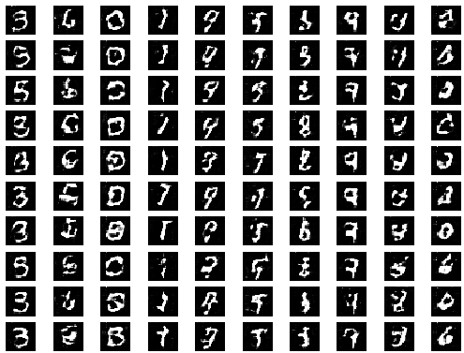
CoIGAN - MNIST to USPS
12,000th Iteration
18,000th Iteration
24,000th Iteration

Slide 29
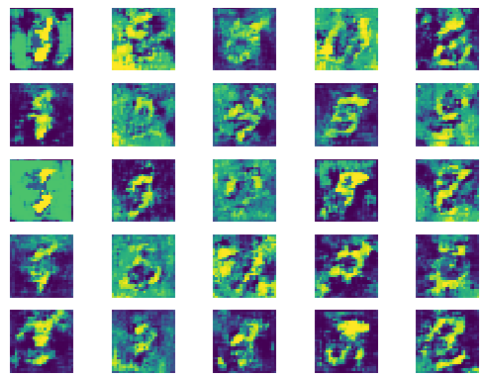
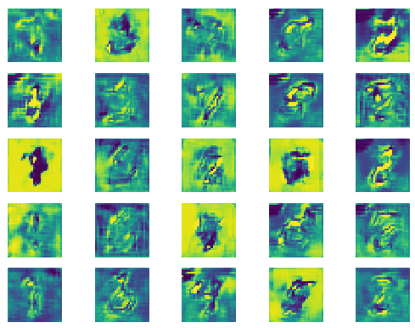
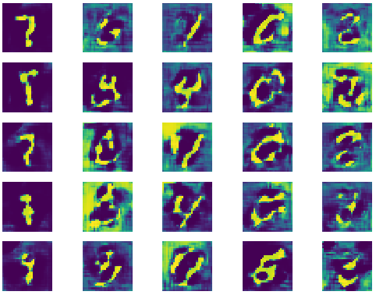
CoIGAN - MNIST to MNIST-M
2,500th Iteration
12,000th Iteration
25,000th Iteration

Slide 30
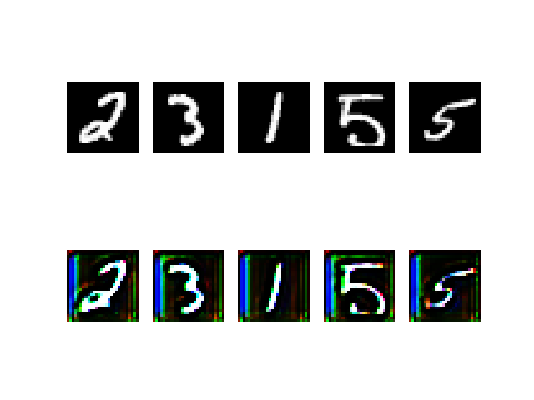
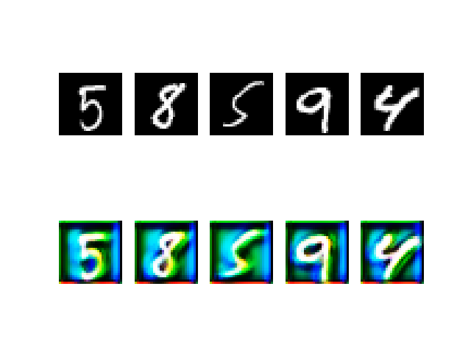
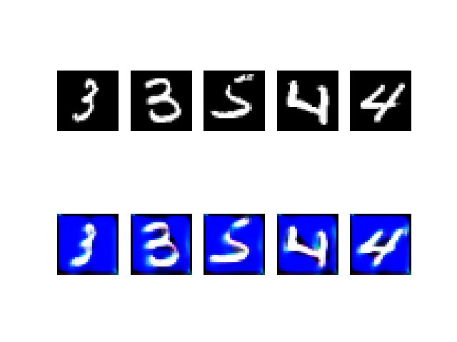
CoPixGAN
Motivation: improve MNIST-M image generation
2 coupled PixelDA GANs
Classification accuracy: 86.27%
Not an unsupervised end-to-end model

Slide 31
Challenges
CPU server processing power
GPU access
Training time
Errors: Directory Path, NAN, Tensor errors, etc.

Slide 32
Budget
$0
Relies on hardware required to run training of models
UCF VM/server
Personal GPUs
Senior design lab computers with NVIDIA 1080 Ti
AWS GPUs and elastic GPUs

Slide 33
Division of Tasks
Research
Google Replication
Devin Cole
Gabriel Ribeiro
Saad Waraich
CoGAN
Maria Mosquera
Saad Waraich
WGAN
Devin Cole
Gabriel Ribeiro
CoWGAN
Maria Mosquera
Saad Waraich
Devin Cole
CoIGAN
Maria Mosquera
Gabriel Ribeiro
CoPix GAN
Maria Mosquera
Devin Cole

Slide 35
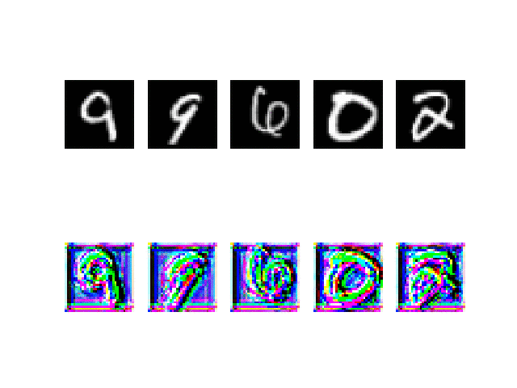
PixelDA

Slide 36
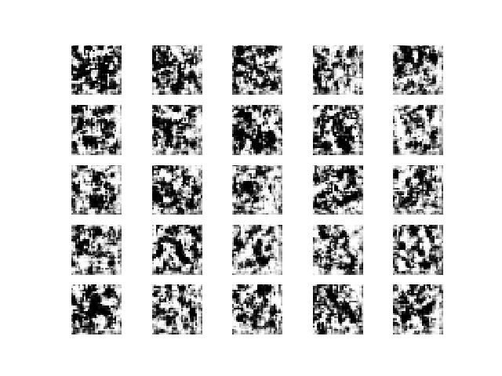
CoWGAN - MNIST

Slide 37
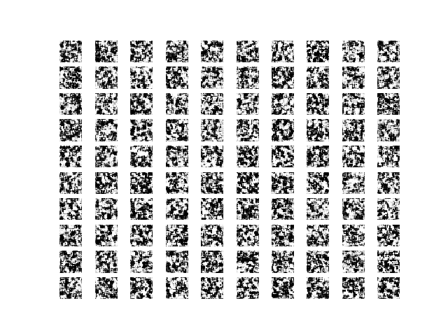
CoIGAN - USPS

Slide 38
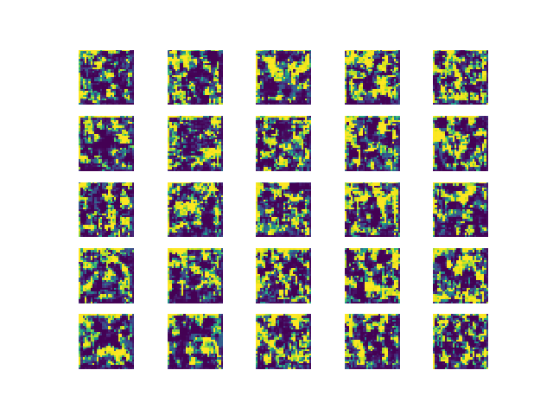
CoIGAN – MNIST-M

